Slide 1
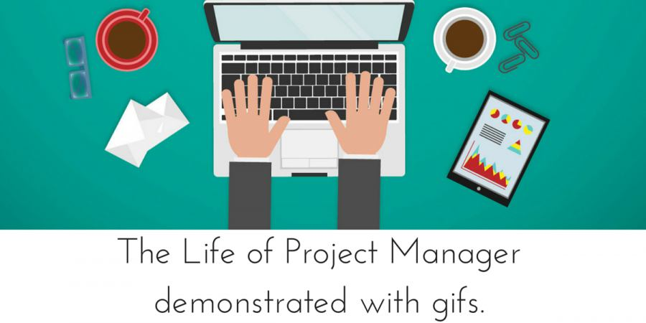
G3T3 Final Presentation
ZhiHui & Nabilah & ShuWen & Darren & Jeremy

Slide 2
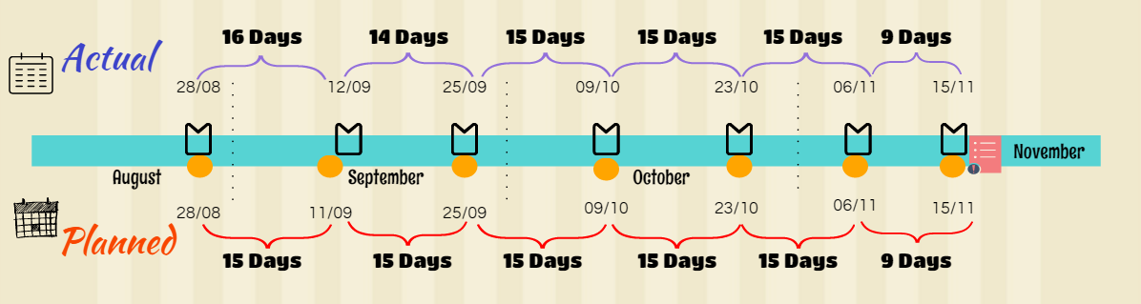
Schedule

Slide 3
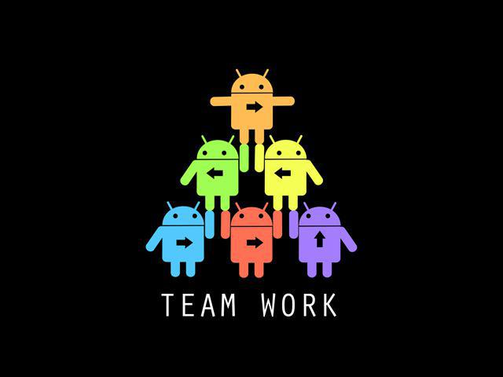
We are Cyan
No dropped functionality
No additional functionalities
No framework

Slide 4

External Libraries
Gson-2.4 (for JSON output)
JWT utility; is203-jwt-v2 (for signing and verifying authentication tokens)
Java CSV (for reading csv files)

Slide 5


Project Manager
Project Management
Write Test Cases
Regression Testing
Ensure everyone does the given tasks
Track all the metrics
Investigate the cause of any deviations(Task Schedule)
Iteration 1 | Jeremy
Iteration 2 | Zhi Hui (SM)
Iteration 3 | Nabilah (PM review)
Iteration 4 | Darren (SM)
Iteration 5 | Shuwen (SM)
Iteration 6 | Jeremy (Final presentation)

Slide 6

Breakdown of work
Functions | Jeremy | Darren | ZhiHui | Nabilah | Shuwen
Bootstrap |  | ✓ |  | ✓ | ✓
Login/Log out | ✓ |  | ✓
Basic App | ✓ |  | ✓
Top-K |  | ✓ |  | ✓ | ✓
Smartphone Overuse |  |  |  | ✓ | ✓
Smartphone Heatmap | ✓ |  | ✓
Social Activeness | ✓ | ✓ | ✓

Slide 7
Hours Spent
20.09% | 20.65% | 19.52% | 20.32% | 19.42%
Member | Hours Spent
Shuwen | 73.99
ZhiHui | 76.07
Jeremy | 71.88
Nabilah | 74.85
Darren | 71.51
Total | 368.3
Notes:
average : 74.33

Slide 8

Fair Allocation of Work
Each member is a PM for at least 1 iteration
Each PM is responsible for a milestone
Each Pair consist of a stronger and less strong coder
Fair share of programming tasks

Slide 9

Schedule Problems & Mitigation
Pm not sure when to close tasks | Rule Set: To inform the PM when the pair complete the tasks
Task is delayed -- cannot compete on time | Rule Set: Pair will inform PM and give a deadline to complete the task
Planning the duration for each tasks underestimation of time required overestimation of time | Adjust as we learn about our biases through experience
Notes:
Tell us about the problems you faced tracking your schedule and how you overcame them.
When someone is done with the task, we don’t whether we should close or not.
Rule Set: To inform the PM whether the pair complete the tasks
Tasks is overdue: Check with the pair
Rule Set: Pair has to give a deadline that they could finished it and to ensure it that it would not affect the next tasks
Planning the duration for each tasks
underestimation of time required
overestimation of time
Very hard to determine the time needed/ experience to tell
Assigning resources
Unfair distribution of work

Slide 10
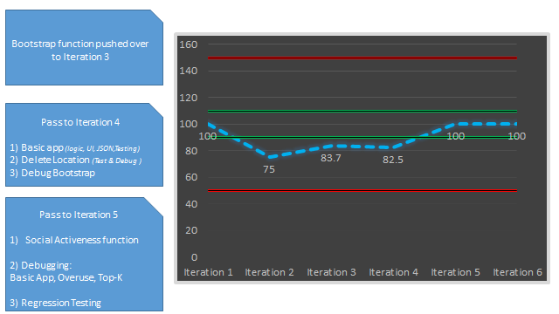
Task Metrics
Pass to Iteration 5
1)Social Activeness function
2) Regression Testing
3) Debugging:
Basic App, Overuse, Top-K
Pass to Iteration 4
1) Basic app
2) Delete Location
(Test & Debug )
3) Debug Bootstrap
Bootstrap function pushed over to Iteration 3

Slide 11
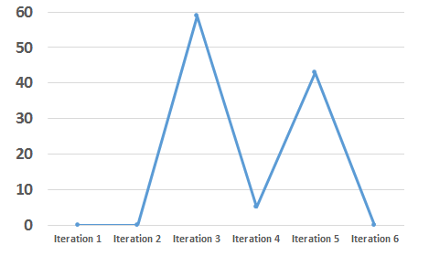
Bug Metrics
Set up a bug squashing task at the start of the next iteration
Proceed with debugging as planned in next iteration
59
43
5

Slide 12

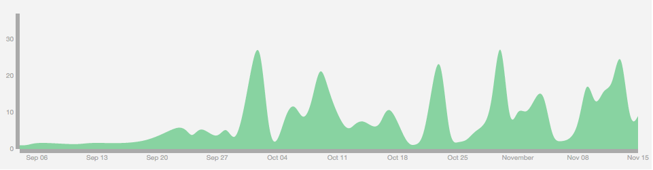
Use of Git
Consistently
Correctly

Slide 13
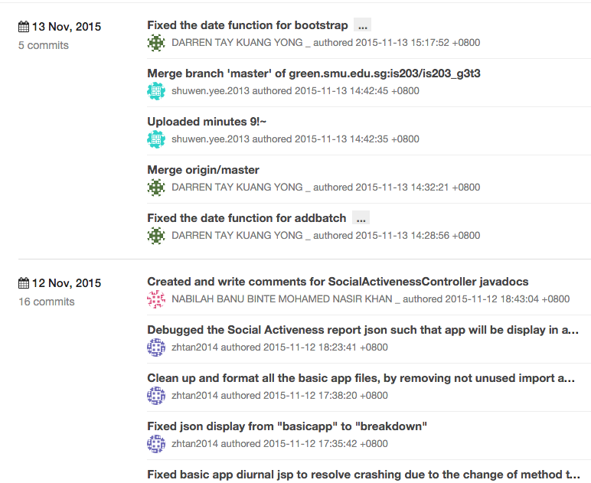

Slide 14
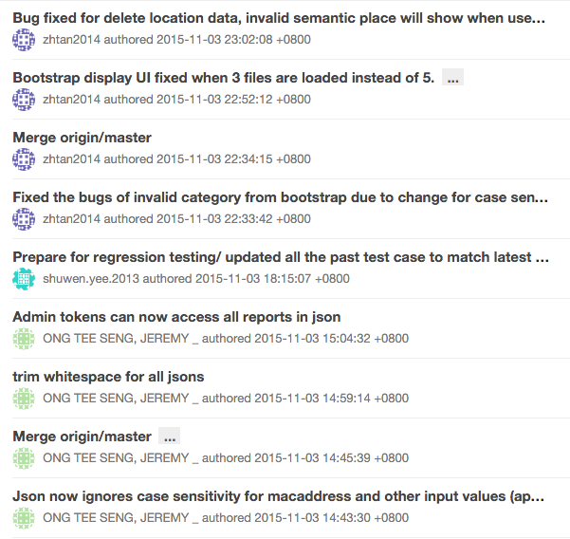

Slide 15
Use of Git - Out of Session commits
Out of 519 commits, these are the accidental commits (excluding reverts)
Iteration 1 | 0
Iteration 2 | 2 (0.4%)
Iteration 3 | 14 (2.7%), of which 4 are merges
Iteration 4 | 6 (1.2%), of which 1 is merge
Iteration 5 | 4 (0.77%), all of which are merges
Iteration 6 | 8 (1.55%), of which 1 is merge

Slide 16
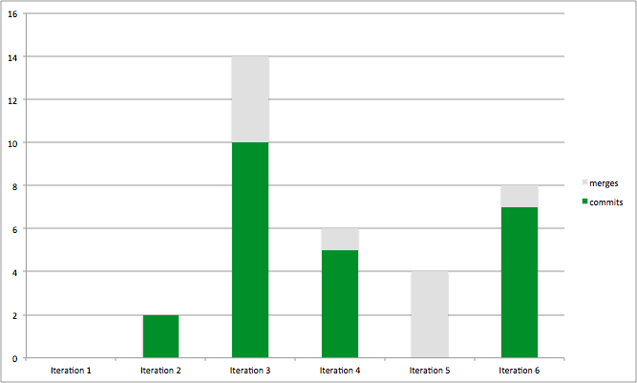
Use of Git - Out of Session commits
Out of 519 commits, these are the accidental commits (excluding reverts)

Slide 17
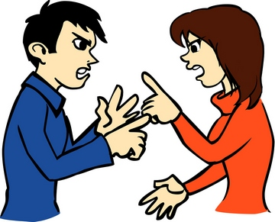
Team Conflicts
- Had a major conflict between LYL and Darren - Darren :0, LYL: 1
- Utility or UserDAO - Darren vs Jeremy - Darren won Scissors Paper Stone
- Otherwise, very chillax

Slide 18

Key Takeaways
I Love Java! I LOVE SE!
If you fail to plan, you plan to fail.
Stick to the plan.
Always do early.
A team won’t work without teamwork
If you are going through hell, keep going
Success consists of going from failure to failure without loss of enthusiasm
Remember remember, the 6th of April #asdf06042015

Slide 19
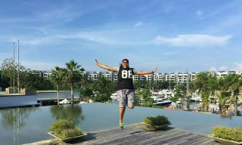
- Address: SIS GSR 3.5
- Ayam Penyet Expert
- Loves to disturb Darren
- No need recharge battery

Slide 20
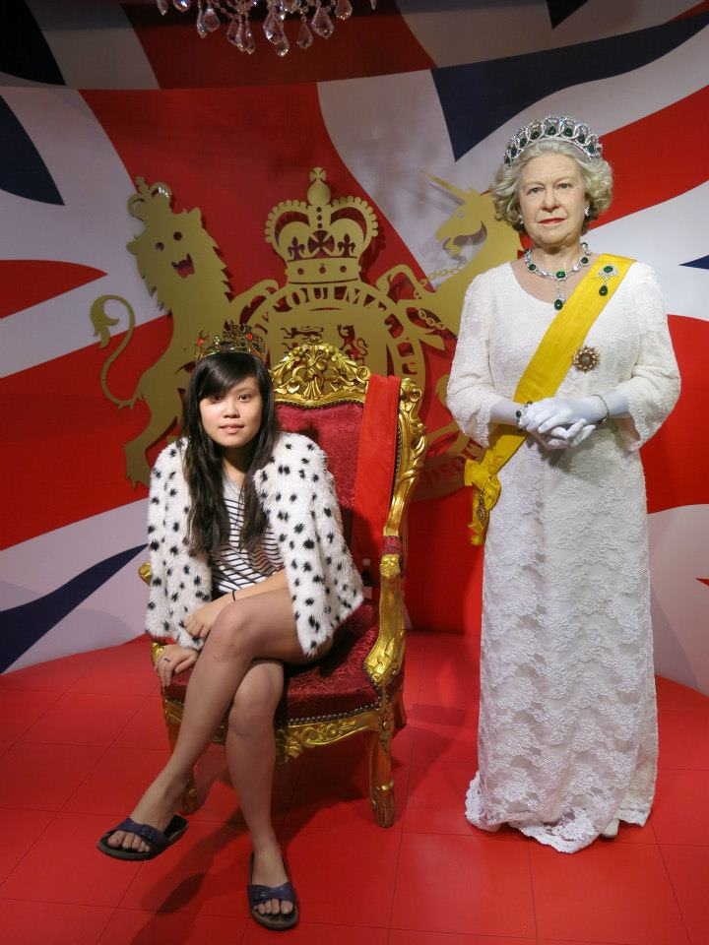
- Taste in food is very Chinese
- Very hyperactive
- Can’t think straight in panic mode
- Internal Auditor of the team

Slide 21
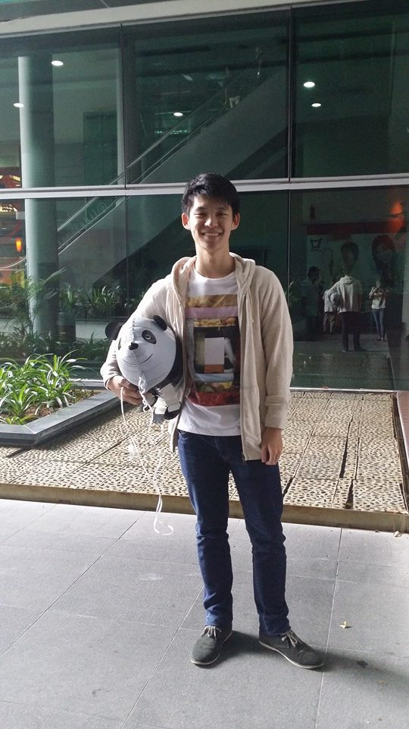
- Thought Teh Chino is Tea plus milo
- Enjoys the thrill of the night
- Very scared of cold
- Wardrobe has only 1 set of clothes

Slide 22
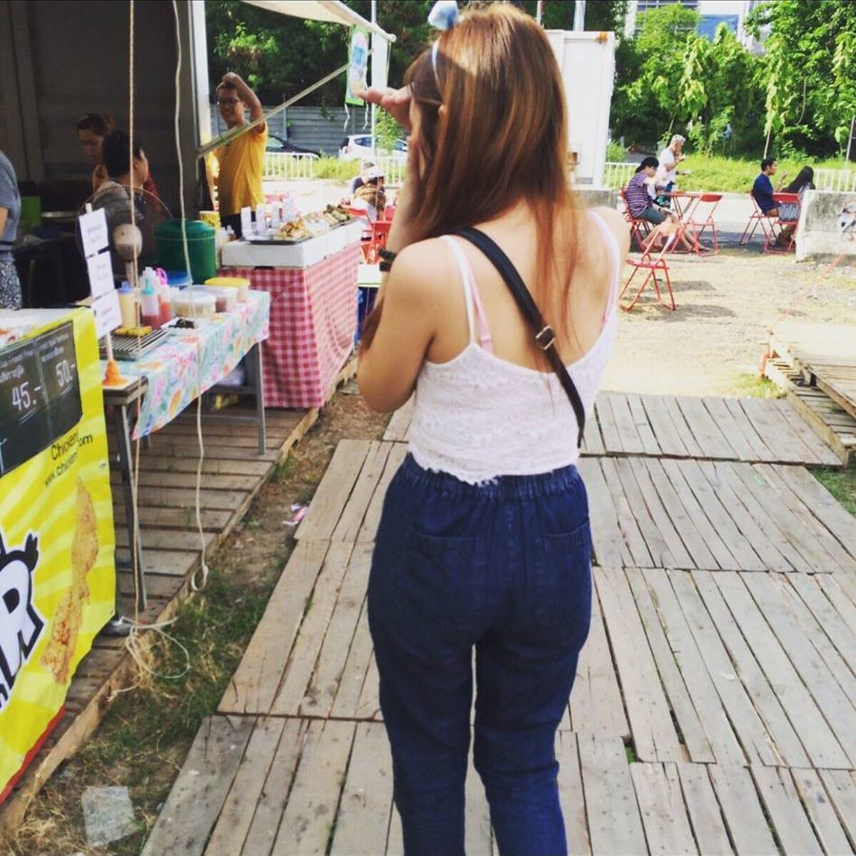
- Don’t know how to use her com
- Windows disguised as Mac
- Got many friends, who got many birthdays

Slide 23
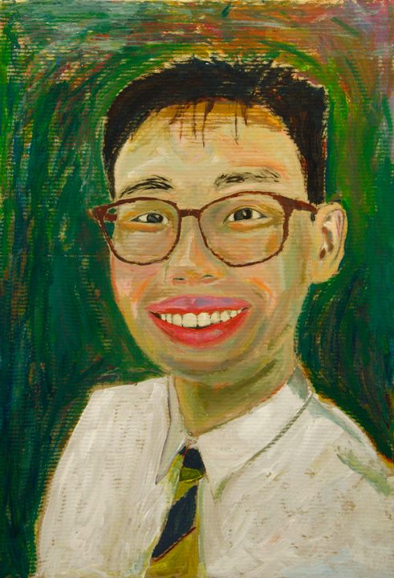
- Panic at wrong timing
- Love Teh Chino
- Abit long winded but its all for our good
- Talk to himself when coding
- Has his own language. need to understand his weird gestures to work well with him

Slide 24
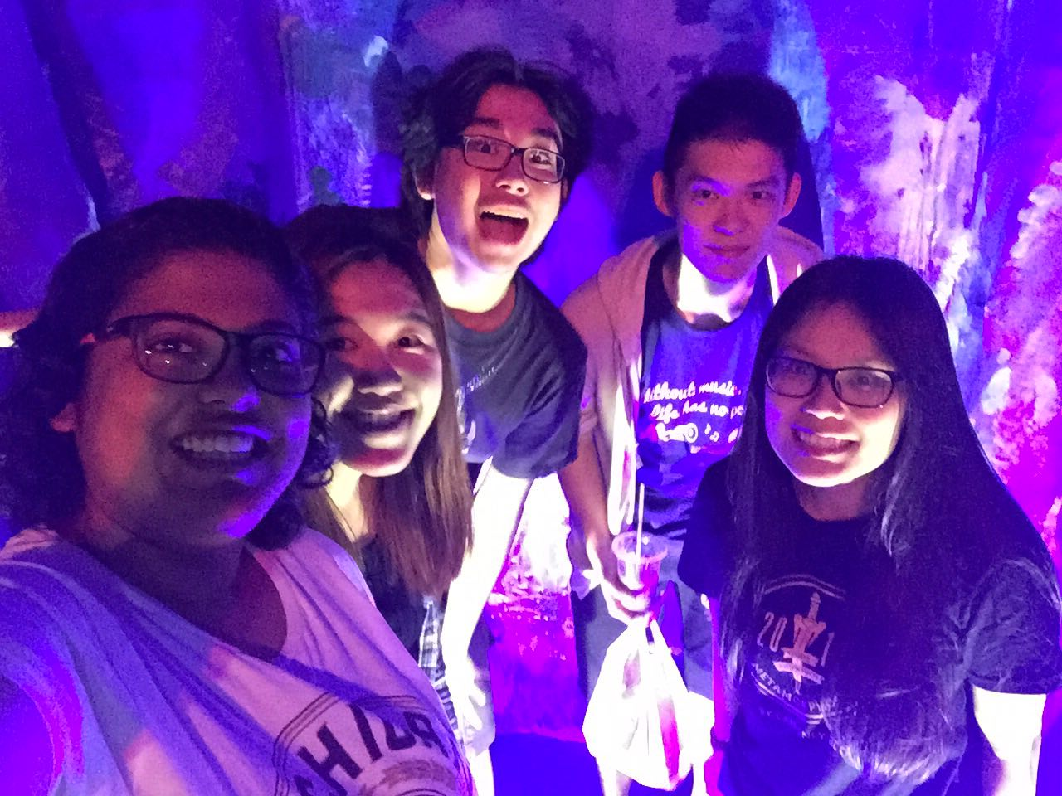
Our crazy team:

Slide 25
The End

